Slide 1





Title
WWDC 19 World Wide
Developer Conference
A3 - Genero Report Writer
a closer look at a few recent features
Laurent Galais
Banyan Tree Mayakoba
30 September – 3 October 2019
Subtitle
Level 1
Level 2
Level 3
Level 4
Level 5
Notes:
Who am I ? Intro Laurent Galais

Slide 2

Genero Report Writer
A closer look at a few recent features
Audience
You are familiar with the GRW architecture
You are familiar with GRW Report Designer & associated BDL code
You have reports in production
Content
Mixed between 3.20 features and other fairly recent features
Some simple, some more complex
Design & Deployment oriented
Selected to highlight value-add & uniqueness to GRW
Complete 3.20 list is available here (Table 7 & 8)
Notes:
Laurent’s personal playlist if you will
No B/O last year, good to do a quick review hopefull giving you ideas
or incentives

Slide 3

Genero Report Writer
Agenda
Inline SubReports
RichTextEdit
Web Viewer
Distributed Mode
Report Schema Transformation
Template creation (if time allows)

Slide 4

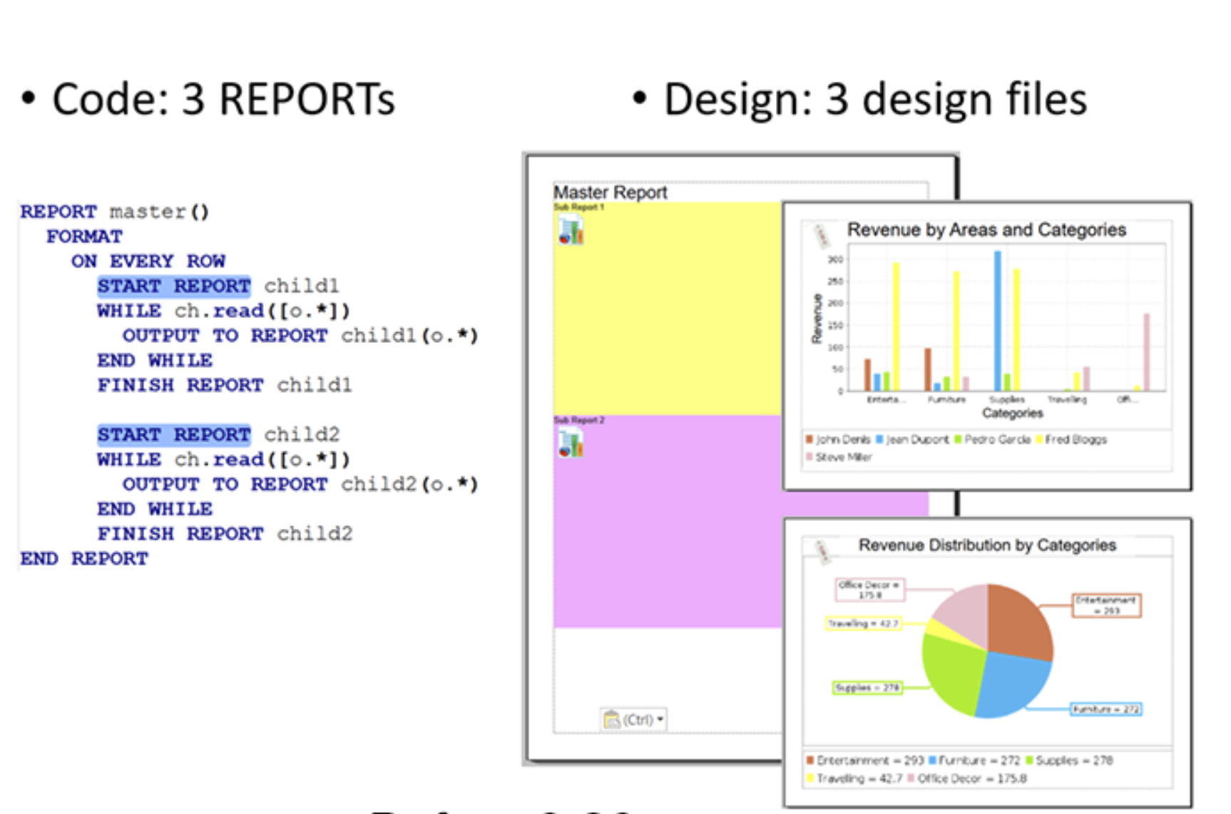
Inline SubReports
Pre-3.20 : linked subreports
Master report is linked to the subreports
3 or more separate .rdd and .4rp files
You can break apart complex designs into smaller reusable parts
Single change to a subreport takes immediate effect in multiple master reports
Notes:
Within Genero Report Writer, the concept of sub reports allowed you to break complex reports into smaller reusable parts. Typical usage would allow you to combine in a single report, two or more charts, or perhaps a chart and the matching data in a table etc. Or you might have a table or chart that you want to appear consistently in a number of different reports. You treat each part separately with its own .rdd and .4rp file, these were known as the sub-reports, and then you had what was known as the master report with its own .rdd and .4rp. The master report was linked to the sub-reports. It typically meant that the report designer had to work with 3 or more .rdd and .4rp files, and they had to visualize in their head what the finished report would look like.

Slide 5
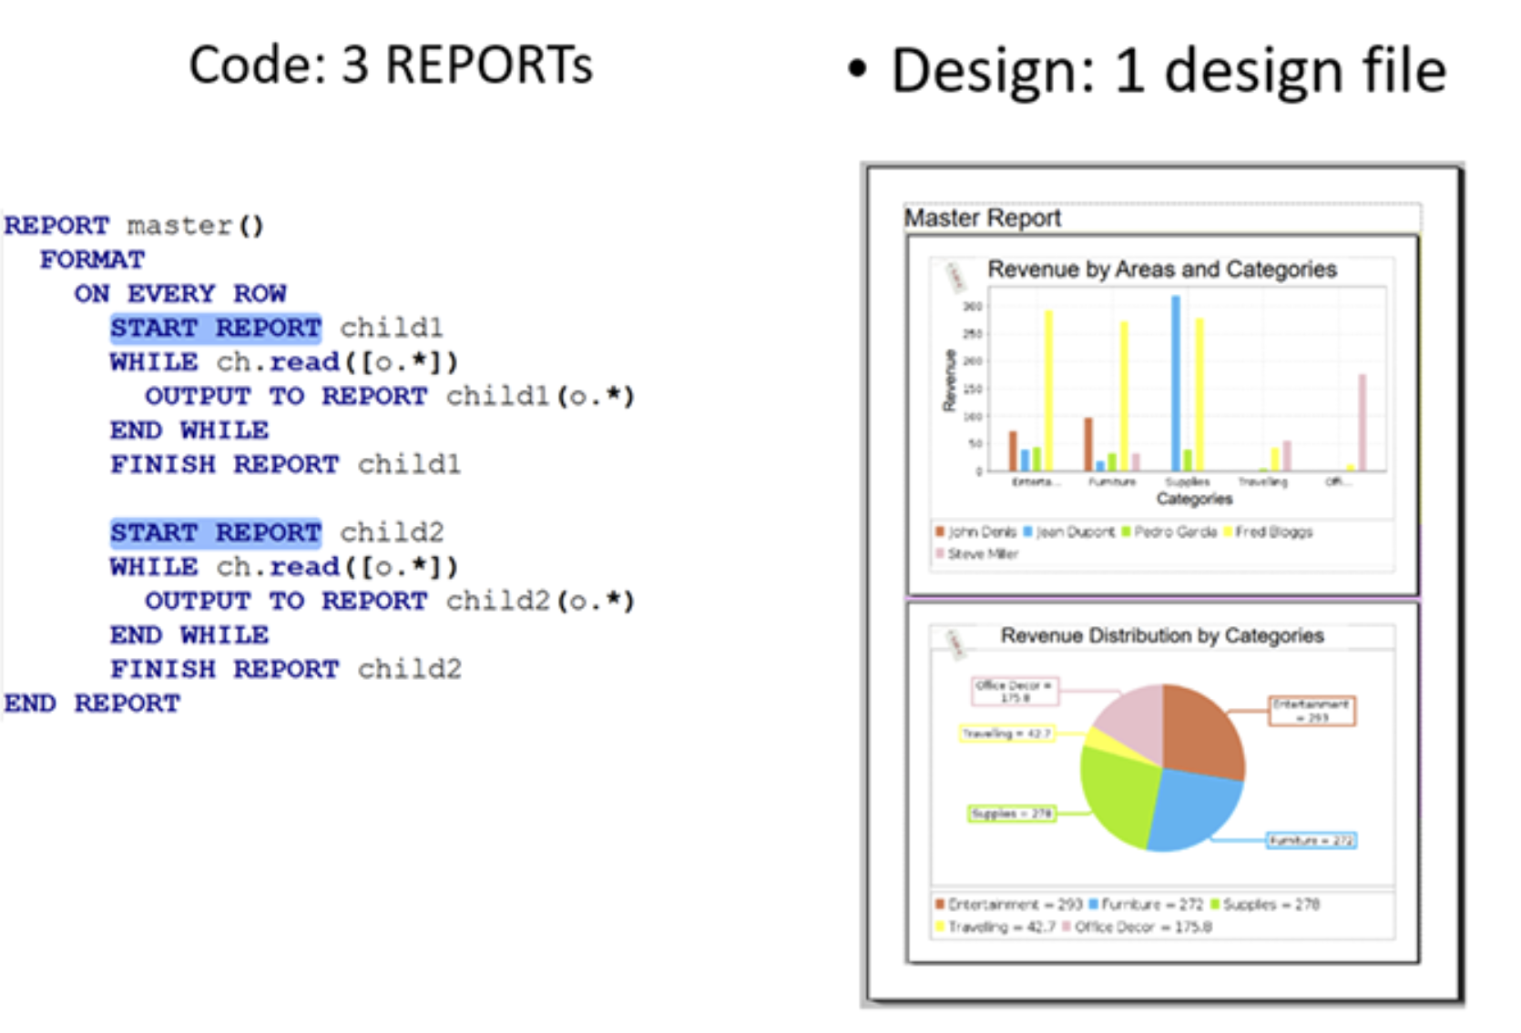
Inline SubReports
New in 3.20
Subreports are embedded in the master
One .rdd and one .4rp file
You can now have a single design that has a model that is simple to code that can contains multiple grouped repetitions
Notes:
Limitation in simple reports: to group , order and aggregate more than once per report
We introduced them because there is no other way to group , order and aggregate more than once per report (you can do as many for loops as you like but then you have to compute the groupings by yourself and there is no automatic BEFORE GROUP or GROUP SUM().
Can contains multiple, potentially adjacent, grouped repetitions (e.g. a grouped list of customers grouped by areas followed by a list of products grouped by types).

Slide 6
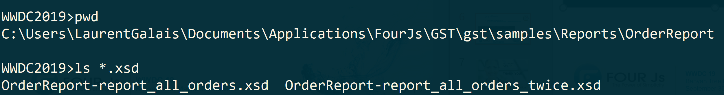
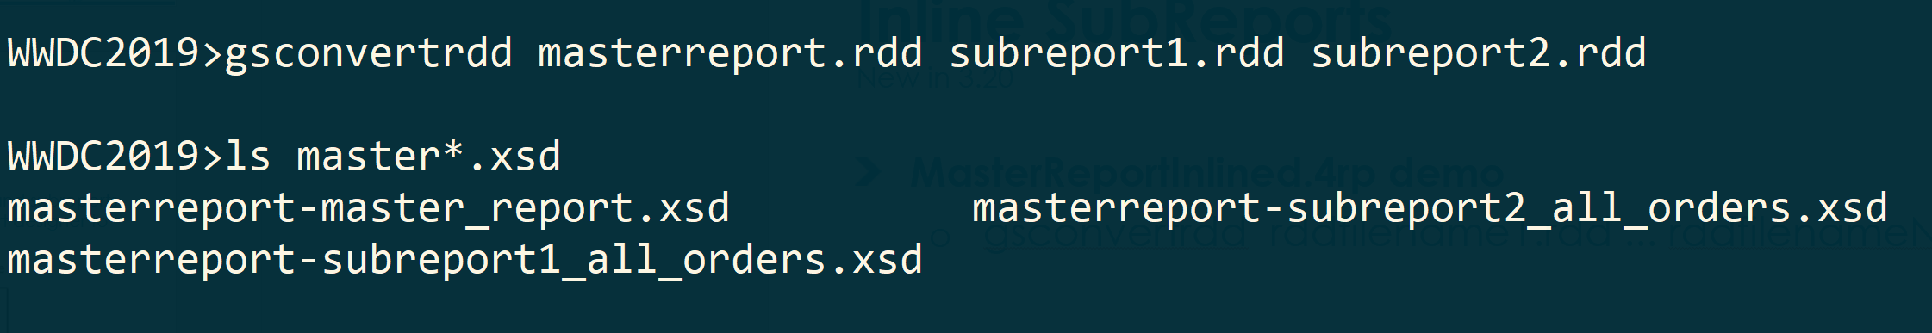
Inline SubReports
New in 3.20
New script provided to merge the master and subreports .rdd files into one to be passed to the report designer to produce one .4rp file
gsconvertrdd rddfilename1.rdd ... rddfilenameN.rddne .rdd
Notes:
MasterReportInlined.4rp demo provided
Only one 4gl containing reports in the OrderReport demo, so only one rdd to work on
This creates .xsd schemas for each report. Use the schema of the master report to design your report, and it will contain all the trigger of the master (orders_twice) and the sub reports (all_orders). You can then edit the master and sub reports in one report design document.

Slide 7
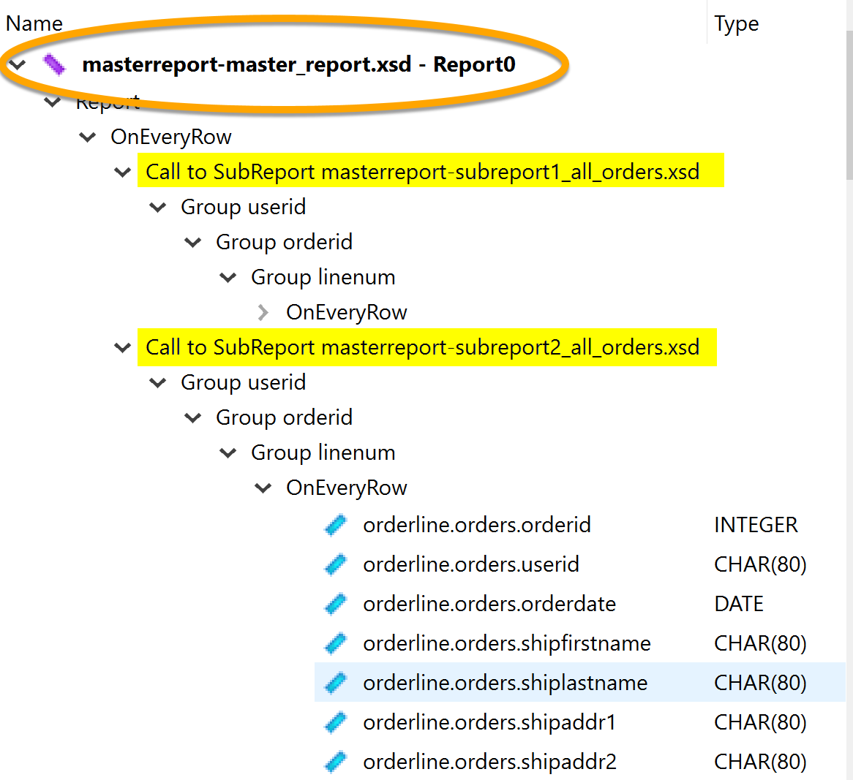
Inline SubReports
New in 3.20
Data View
Notes:
In the Data View for the master report, open the XSD file for the master report. The data for all sub-reports is included

Slide 8
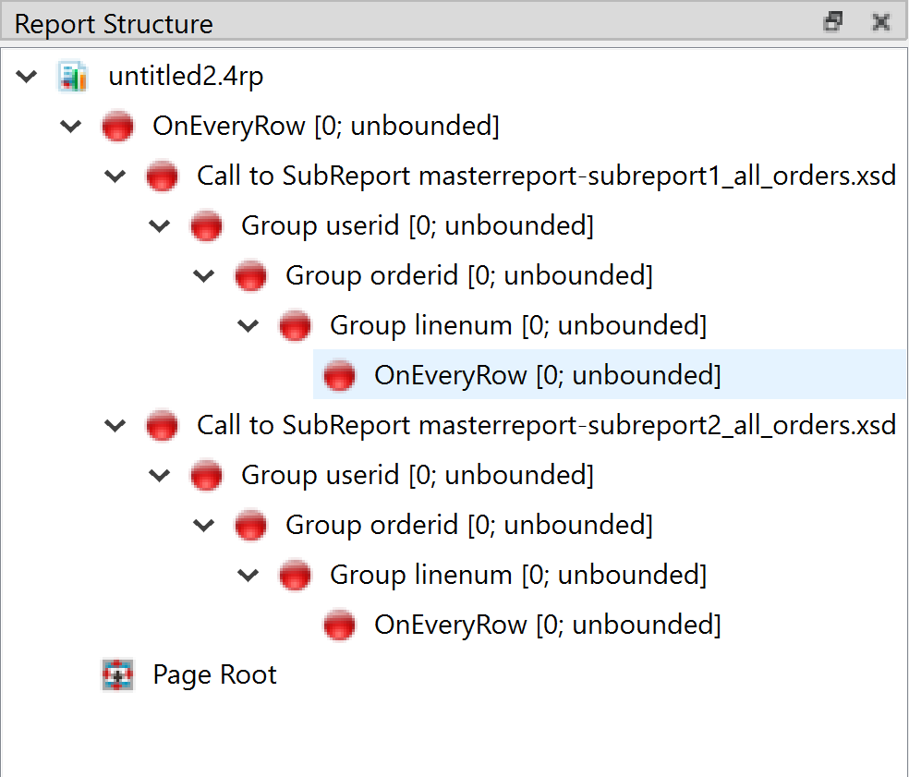
Inline SubReports
New in 3.20
The Report Structure view
Notes:
A trigger is created for each trigger in the sub-reports (initial setting)

Slide 9
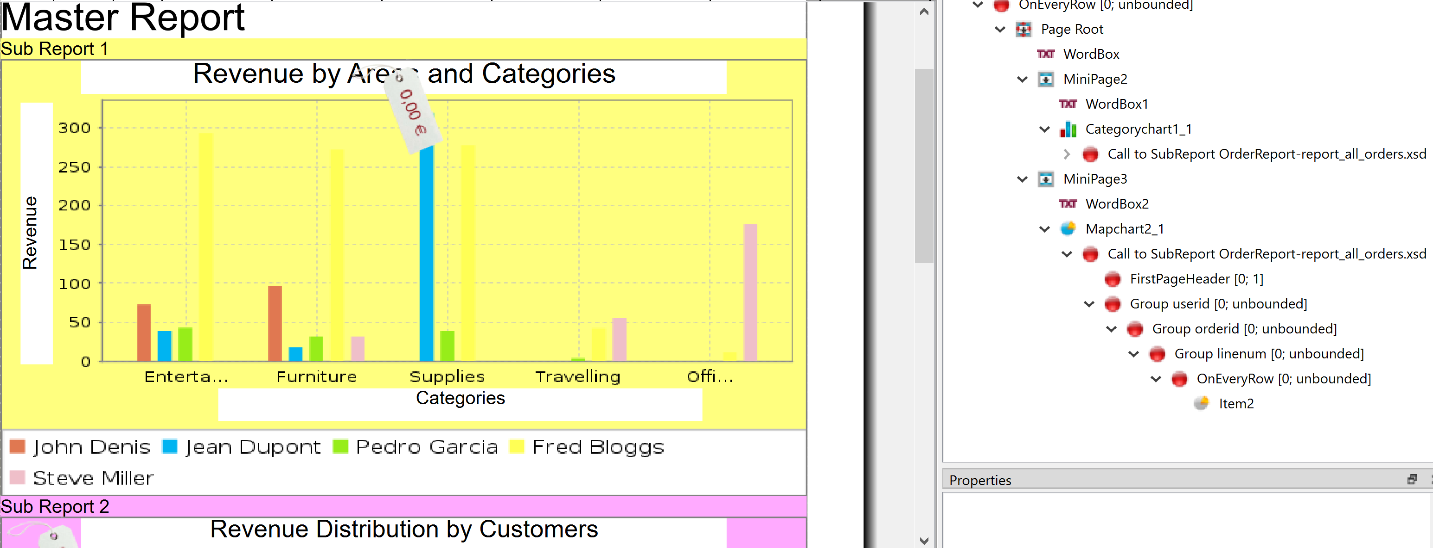

Inline SubReports
New in 3.20
Add objects and edit the report structure as required

Slide 10

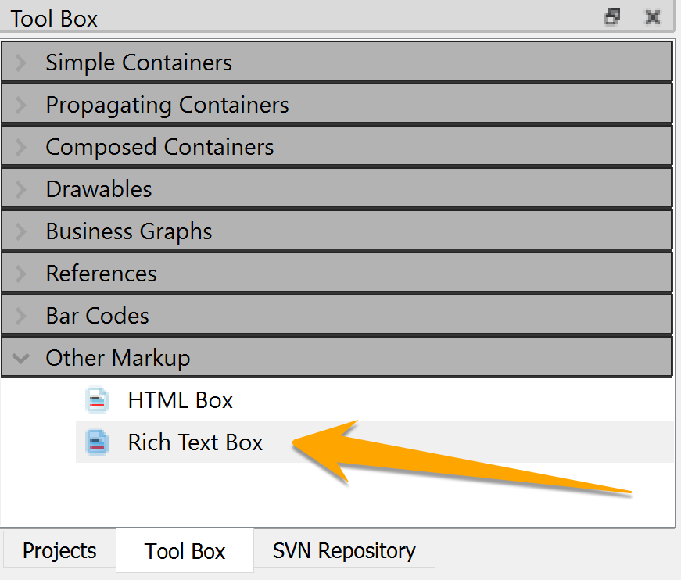
Rich Text Box
Toolbox addition in 3.20
Displays an image of an HTML, XHTML, or PXML document in the report
Provided to render rich text input from the ‘fglrichtext’ Web Component into documents
Notes:
In the past complex process if one wanted to display richtext from GDC in an HTMLBOX. Now we provide a way that works without quirks for both GDC and GBC. But we are not attempting to write a Browser (that is an impossibly large task for us). Over time I expect the RICHTEXTBOX to get more capable (for the moment it doesn't even support TABLE) but it will never be Chrome or Firefox compatible.

Slide 11
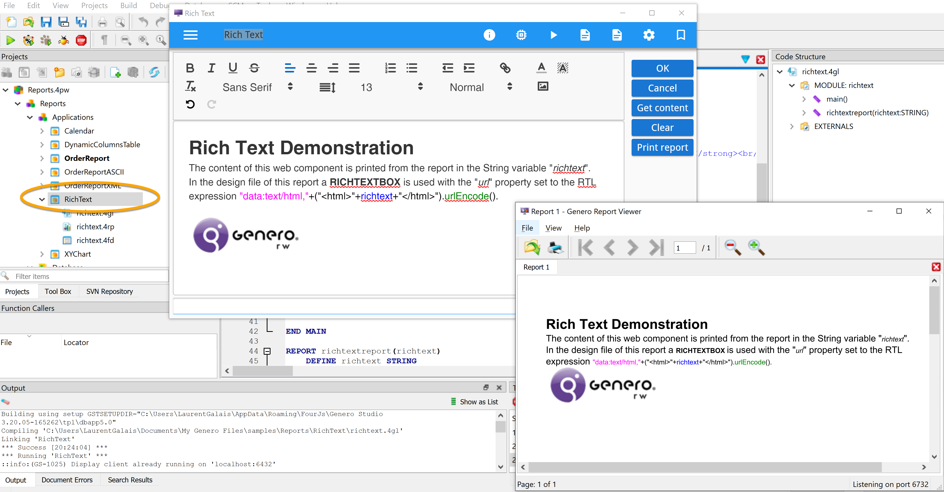
Rich Text Box
Toolbox addition in 3.20
RichText sample provided in GST ‘Reports’ demo
Notes:
Paragraph, Break, Date Format Box but those are pretty straightforward
Data you input via the fglrichtext Web Component should be output through the new Rich Text Box
A property of the Rich Text Box is that it will propagate if the content goes across a page break, something that the existing HTML box does not.

Slide 12
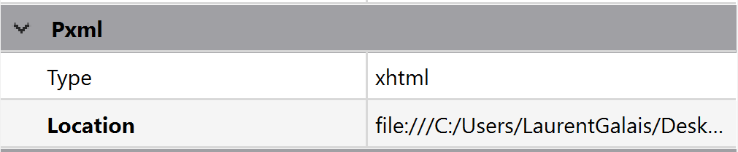
Rich Text Box
Toolbox addition in 3.20
Properties
Type: specifies whether the document is HTML, XHTML, or PXML
Location: Specifies the file name and path of the document

Slide 13
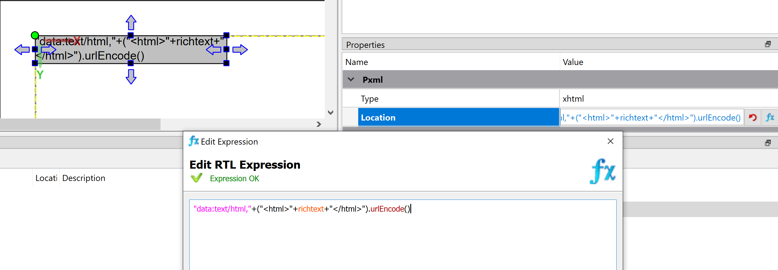
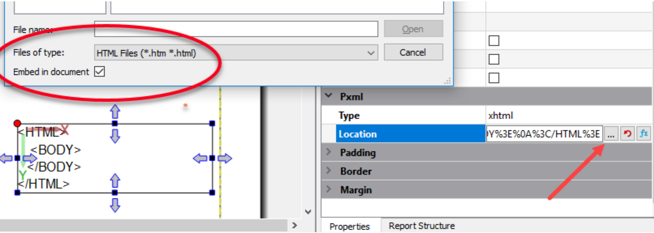
Rich Text Box
Toolbox addition in 3.20
Embed documents in the Location property
You can use the data protocol syntax
Following the data URI scheme
‘data:text/xml, data’ for PXML, ‘data:text/html, data’ for HTML/XHTML
You can use the expression editor to integrate a variable
Notes:
Redo this screenshot

Slide 14
Rich Text Box
Toolbox addition in 3.20
Considerations/Limitations
Not all CSS styles nor HTML elements are supported by the Rich Text Box
Check the documented support list for both (CSS here and HTML here)
Properties or elements that are not supported may silently be ignored at runtime
CSS styles must be contained in the HTML document using a <style> element
References to external CSS files (for example, using <link> tags) are not supported
Notes:
We are not attempting to write a Browser (that is an impossibly large task for us).
WIP: Over time I expect the RICHTEXTBOX to get more capable (for the moment it doesn't even support TABLE) but it will never be Chrome or Firefox compatible.

Slide 15

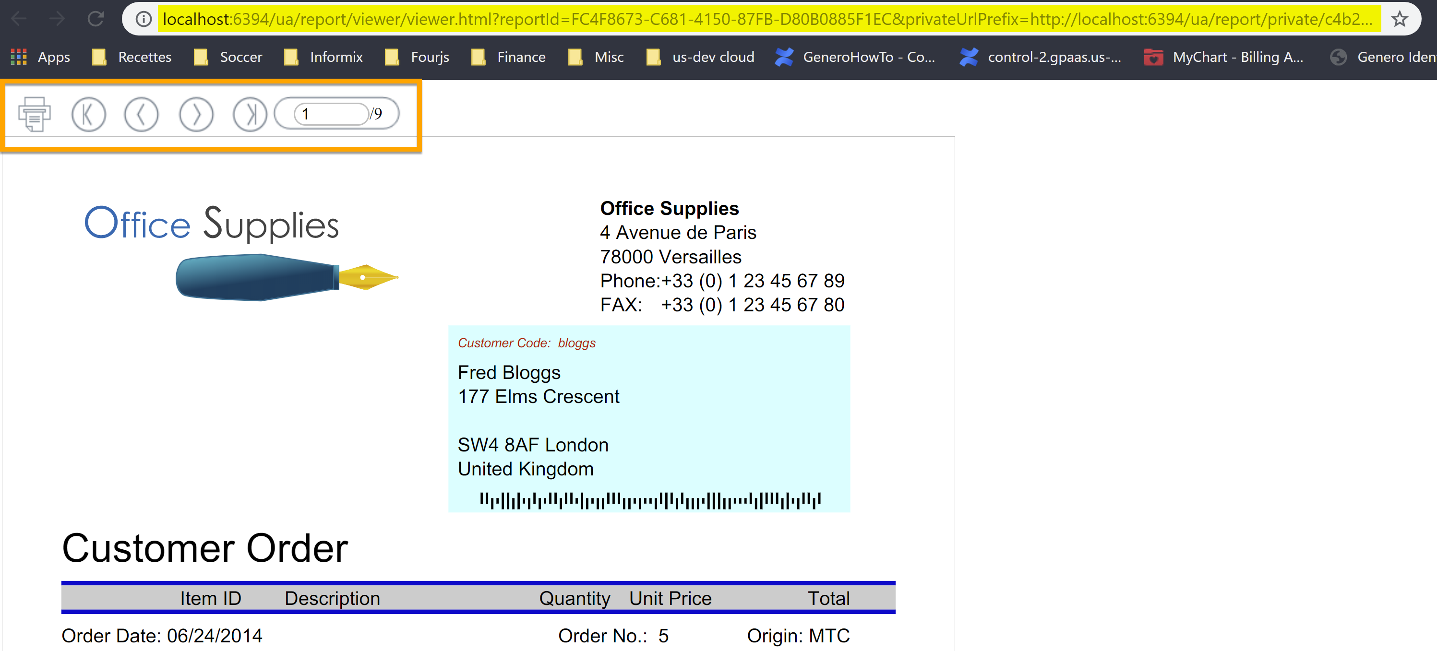
Web Viewer
3.10 Feature
View reports in a browser with Genero Report Viewer for HTML5
Equivalent to the Report Viewer (GRV) embedded in GDC
You can start viewing the report as it continues to stream

Slide 16
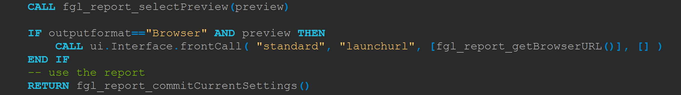
Web Viewer
Simple/Default setup
Demo program ‘OrderReport.4gl’
CALL fgl_report_getBrowserURL (new in 3.20)

Slide 17
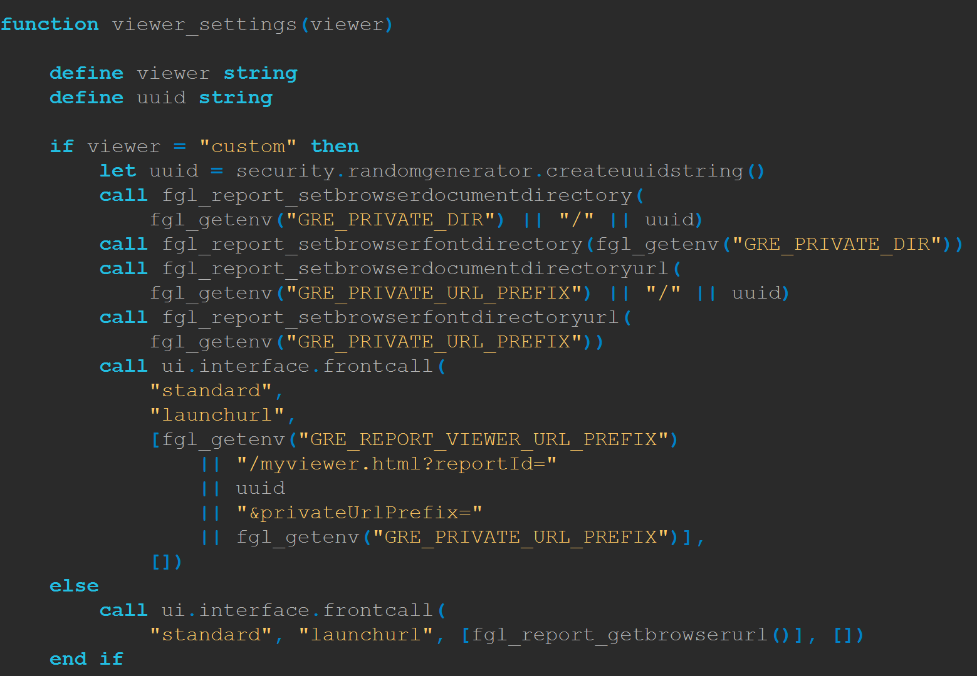
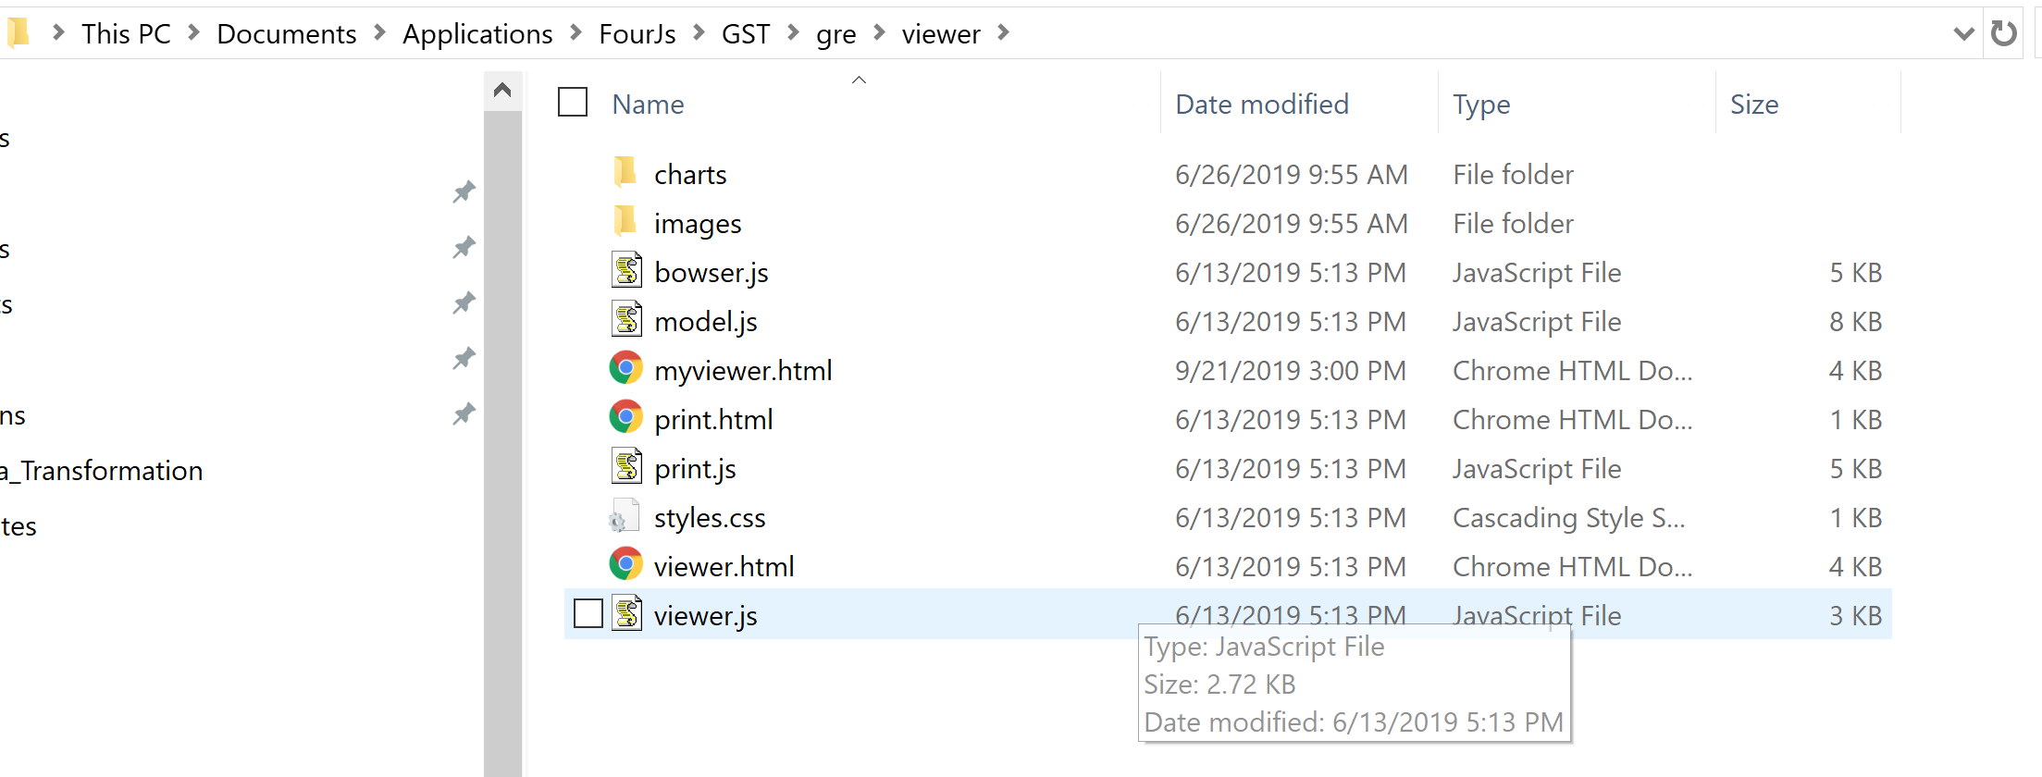
Web Viewer
Customization
You can change these values if required by calling some additional APIs
The complete GREDIR/viewer directory can be copied and modified
Notes:
Show preview GDC vs GBC/GAS
Show where the files are
Modify myviewer to show it can be completely customized
Show as.xcf

Slide 18
Web Viewer
Default Environment (Non-Distributed or Local-Distributed Mode)
The browser directory and URL, and the font directory and URL, are automatically set under prefix ‘$(connector.uri)/ua/report/’
Env. Variable | Description | Example | Location
GRE_REPORT_VIEWER_URL_PREFIX | URL prefix of Genero Report Viewer for HTML5 | http://localhost:6394/ua/report/viewer | GREDIR/viewer
GRE_PRIVATE_URL_PREFIX | Private URL prefix | http://localhost:6394/ua/report/private/9be6b38671... | APPDATA/tmp/dispatcher_name/$(session.id)/reports
GRE_PUBLIC_URL_PREFIX | Public URL prefix | http://localhost:6394/ua/report/public | APPDATA/public
GRE_PRIVATE_DIR | Private resource directory | private/89be6b3867148e738f… | APPDATA/tmp/dispatcher_name/$(session.id)/reports
GRE_PUBLIC_DIR | Public resource directory | public | APPDATA/public
Notes:
If you are using a private directory (GRE_PRIVATE_DIR and GRE_PRIVATE_URL_PREFIX), only the current session will be able to view the report, and the report will be deleted when the session ends.
If you are using a public directory (GRE_PUBLIC_DIR and GRE_PUBLIC_URL_PREFIX), the report can be shared and bookmarked.
The environment variables GRE_PRIVATE_DIR, GRE_PRIVATE_URL_PREFIX, GRE_PUBLIC_DIR, and GRE_PRIVATE_URL_PREFIX are automatically set in the GAS. You should never explicitly set these variables in Genero Studio.

Slide 19

Distributed Mode
Production preferred mode
GRE started as a daemon on Server
GREDIR/bin/greportwriter –l <port>
Genero application connects to the daemon
CALL fgl_report_configureDistributedProcessing
CALL fgl_report_configureDistributedEnvironment
You can also use GREREPORT
Benefits
Faster processing for short documents
Improved scalability
Notes:
In production, always choose distributed mode to avoid slow start for short documents and extra resource consumption
Advantage:
Faster processing for short documents
In normal mode, the JVM is started up each time you run a report
Can affect the overall performance
In distributed mode, the JVM is started once: Improvement in performance for report batches
Improved scalability
Formatting graphical reports is CPU expensive: can affect performance
Distributed mode: Offload the report processing to another server

Slide 20
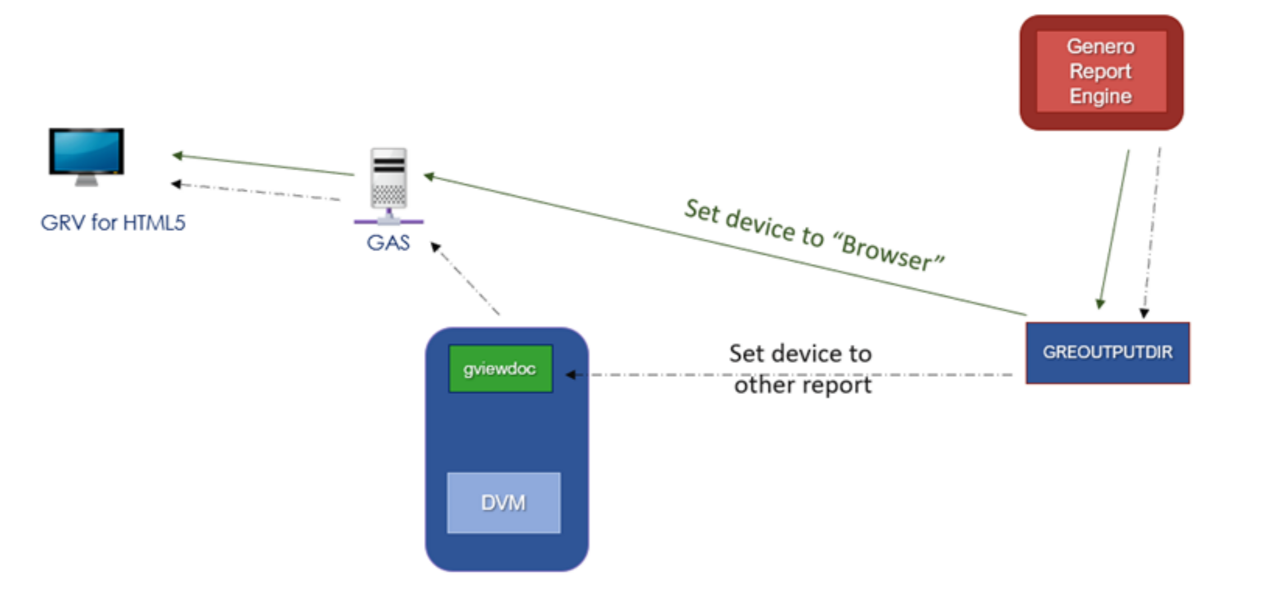
Distributed Mode
Local vs Remote
Local Distributed
JVM is started and initialized only once

Slide 21
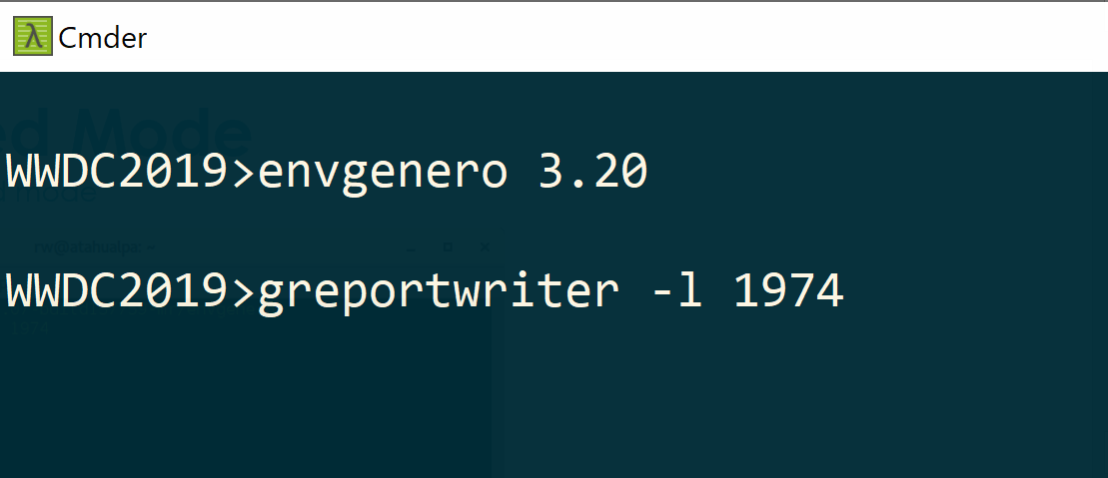
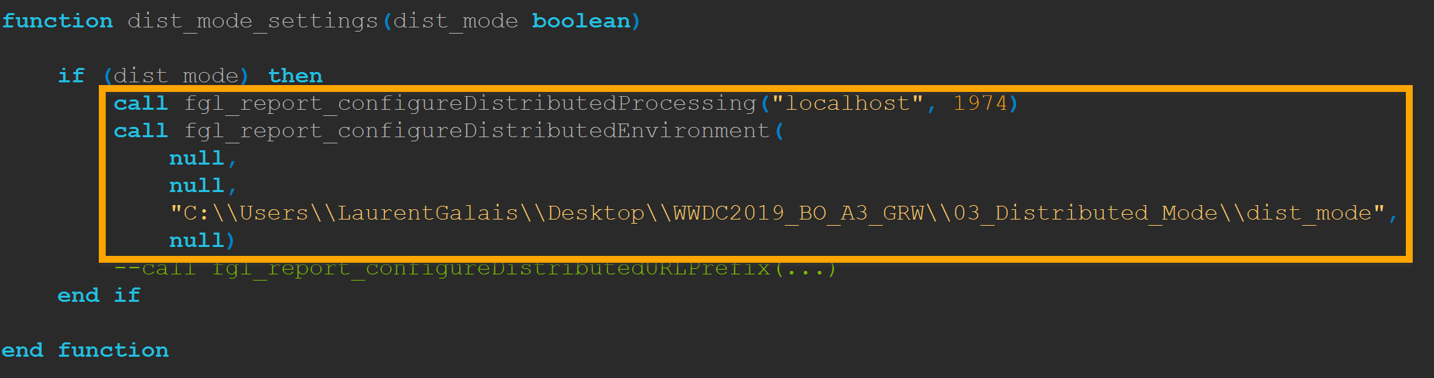
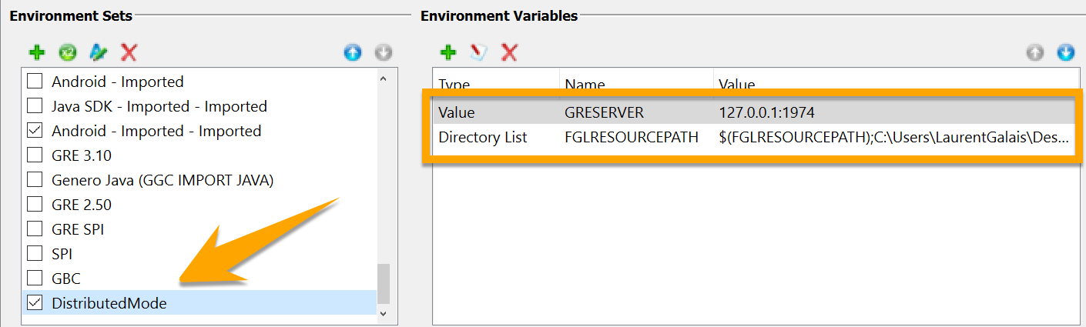
Distributed Mode
Production preferred mode
Notes:
Or use GRESERVER=localhost:1974
Since version 3.20, if the GRE daemon isn't started, the process automatically switches to "normal" mode instead of distributed mode". That's why the report is still running (but of course, you need to have a GRE installed and configured locally)
Normally, the environment variable GRESERVER should work in the same way as the API fgl_report_configureDistributedProcessing() (but the API has higher priority in case both are used). Can you try with 127.0.0.1 instead of 'localhost'? Or the real IP?

Slide 22
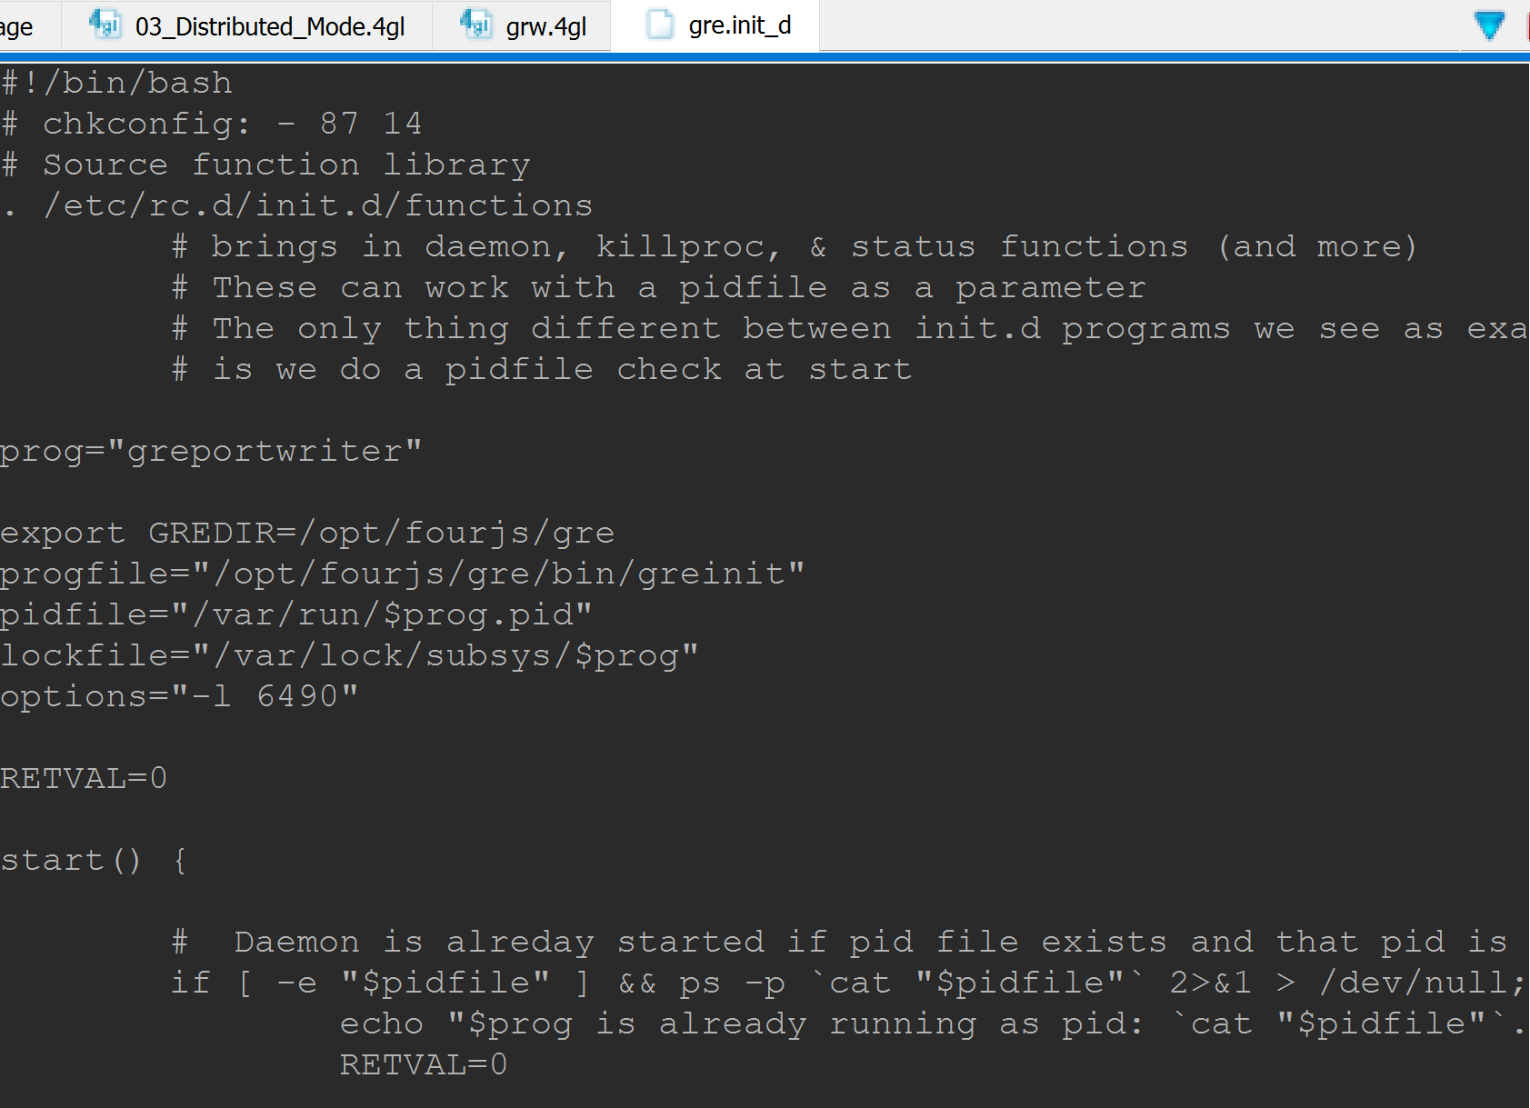
Distributed Mode
Recommendations
Additional resources
On top of report design files, ensure that the fonts, images, and printers required for the reports are accessible
Manage the Report Server using a Unix or Windows Service
The service can’t die in production mode
Example for Linux init.d provided in the samples for this session
Trap the error properly if the server is not available to produce documents
Notes:
Unfortunately, there's no way to know if the GRE daemon is running or not. The error checking APIs you are mentioning don't provide any information on that. But we should provide an option to inform if GRE daemon is reachable or not. A new feature request has been filed therefore: GRE-777.

Slide 23
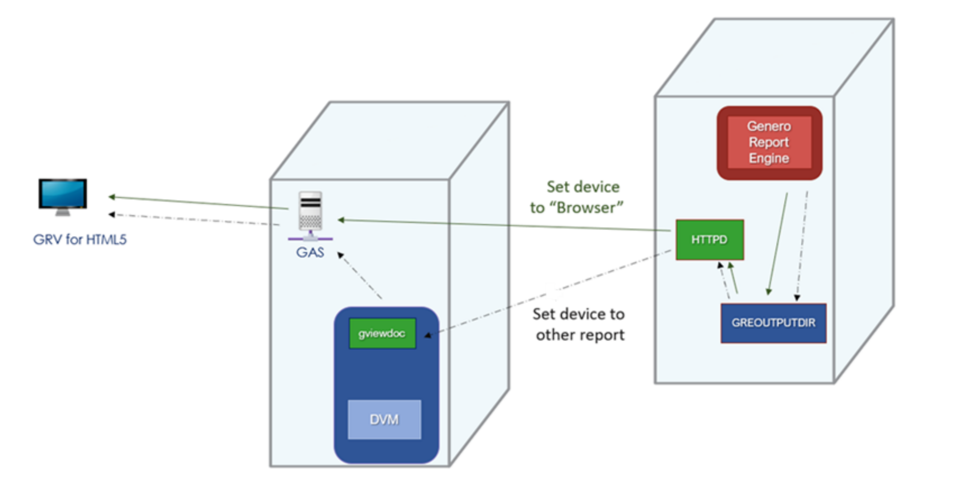
Distributed Mode
Local vs Remote
Remote Distributed
Improved scalability
Formatting graphical reports is CPU expensive: can affect performance
Offload the report processing to another server
Notes:
In remote distributed mode, the application and the Genero Report Engine are started on different machines. The advantages of a remote distributed architecture: Your IT policy might require the GRE and application sit on separate machines.
Remote distributed mode allows for improved scalability. Formatting graphical reports is CPU intensive, and CPU is usually expensive on a server optimized for IO (such as servers running the DVM and/or the database). Remote distributed mode allows offloading the report processing to a cheaper machine, such as a standard PC.
The required fonts might sit on a specific machine. Specifically, a dedicated report formatting PC could be installed with Windows™, which has the additional advantage of handling fonts and printers in a user-friendly way.
Not showing SVG

Slide 24
Distributed Mode
Remote Setup
Place report design documents & resources on the daemon server & start it
.4rp files, fonts, images
greportwriter -l 6500
Start the GRE remote web server service
To produce any doc type other than SVG
GREDIR/bin/ grehttpd –l 12345
Configure GAS to proxy the requests
<REPORT_REMOTE_URL_PREFIX>http:// PrintServer :12345<…
Adapt code to connect to a daemon using the reporting API
fgl_report_configureDistributedProcessing("PrintServer",6500)
Notes:
More complex – just know it’s available
Only fgl_report_configureDistributedProcessing works

Slide 25
Distributed Mode
Remote Setup
The url prefix to be used is ‘$(connector.uri)/ua/report-r/’
GAS proxies these URLs on the remote server using REPORT_REMOTE_URL_PREFIX specified
Env. Variable | Description | Example
GRE_REPORT_VIEWER_R_URL_PREFIX | URL of the server where the GRE daemon is running | http://localhost:6394/ua/report-r/viewer
GRE_PRIVATE_R_URL_PREFIX | Private URL prefix | http://localhost:6394/ua/report-r/private/9be6b38671...
GRE_PUBLIC_R_URL_PREFIX | Public URL prefix | http://localhost:6394/ua/report-r/public
GRE_PRIVATE_R_DIR | Private resource directory | private/89be6b3867148e738f…
GRE_PUBLIC_R_DIR | Public resource directory | public

Slide 26

Report Schema Transformation
Concepts
Transform the extracted Raw XML Data Stream before it is sent to the Genero Report Engine
RST file
Used in Designer
In the same way as RDD or XSD
Data view shows schema with specified transformations
Used at runtime (in GRE)
Apply transformations to data in serial manner

Slide 27
Report Schema Transformation
Scope
Multiple reports, some using detailed data from the data source, and others using only simple data
Multiple reports that group and aggregate the detailed data in different ways
The data source is a fixed third-party source, but you need to group and aggregate the data in a different way than is supplied by the source
The data is needed more than once, but issuing two SQLs to retrieve it is not an option because the data cannot change between queries

Slide 28
Report Schema Transformation
Features
Grouping data using variables
Sorting data
Before or after grouping
Duplication of any part of the document
Use the same data multiple times in report
Shifting record lists and variables
Computing aggregates
Average, minimum, maximum
Computing running aggregates
Printing values that depend on page breaks
Notes:
Filter - Instead of sending a Raw XML DataStream with every available field, filter it so that only fields used in a report are sent. This will lead to efficiencies if generating multiple reports from this data stream, or perhaps transmitting over a network. (On Page 1 of the Wizard just select the fields you want)
Duplicates - Do you want to print a detail report with a summary page, or two charts of the same data. Use the transformation process to duplicate the data in your raw XML data stream (On Page 1 of the Wizard, select the same group/field multiple times)
Moving - If you print totals calculated from an AFTER GROUP you will know that you can currently only print these at the end of the group. Using transformations you can take what was placed in a node from an AFTER GROUP, and copy it up to the equivalent node in the BEFORE GROUP. This then enables you to Print totals on Page 1 of an Invoice, rather than the last page. (On Page 1 of the Wizard, use arrows on right hand side to move fields around)
Reordering/Group - I have not figured this one out yet, but I hope it will solve the following problem. If you have stock data, the Warehouse/Branch manager would like the report sorted and grouped by Warehouse/Branch, whilst the Product Manager would like the report sorted by Product Group/Product Code etc. Currently this requires two hits of the database and two separate data streams, one for each order by sequence. Using transformations you should be able to hit the database once and reorder/group the data as you require (Page 2 of the Wizard)
Calculation/Aggregation - Your Raw XML DataStream might not have aggregations/totals but using transformations you can add them into the Raw XML DataStream. Similarly running totals can be inserted. (Page 3 of the Wizard)

Slide 29
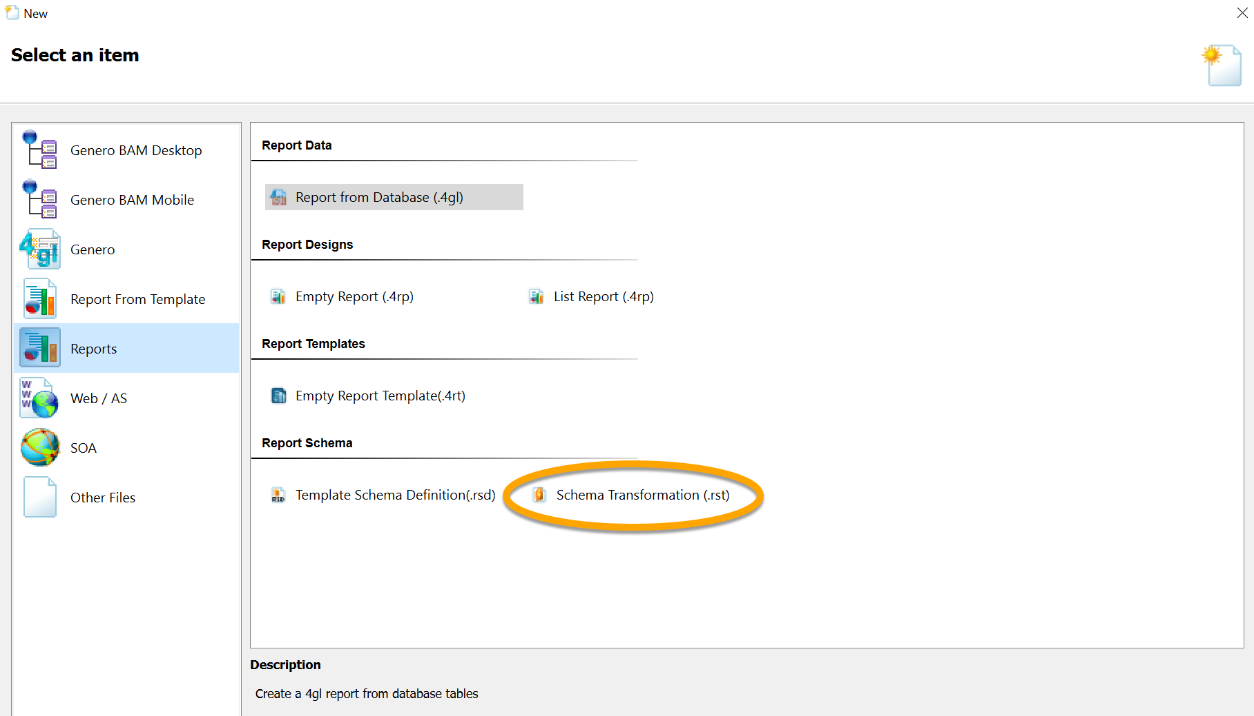
Report Schema Transformation
Steps
Create a new schema transformation
File > New > Reports > Report Schema > Schema Transformation (.rst)

Slide 30
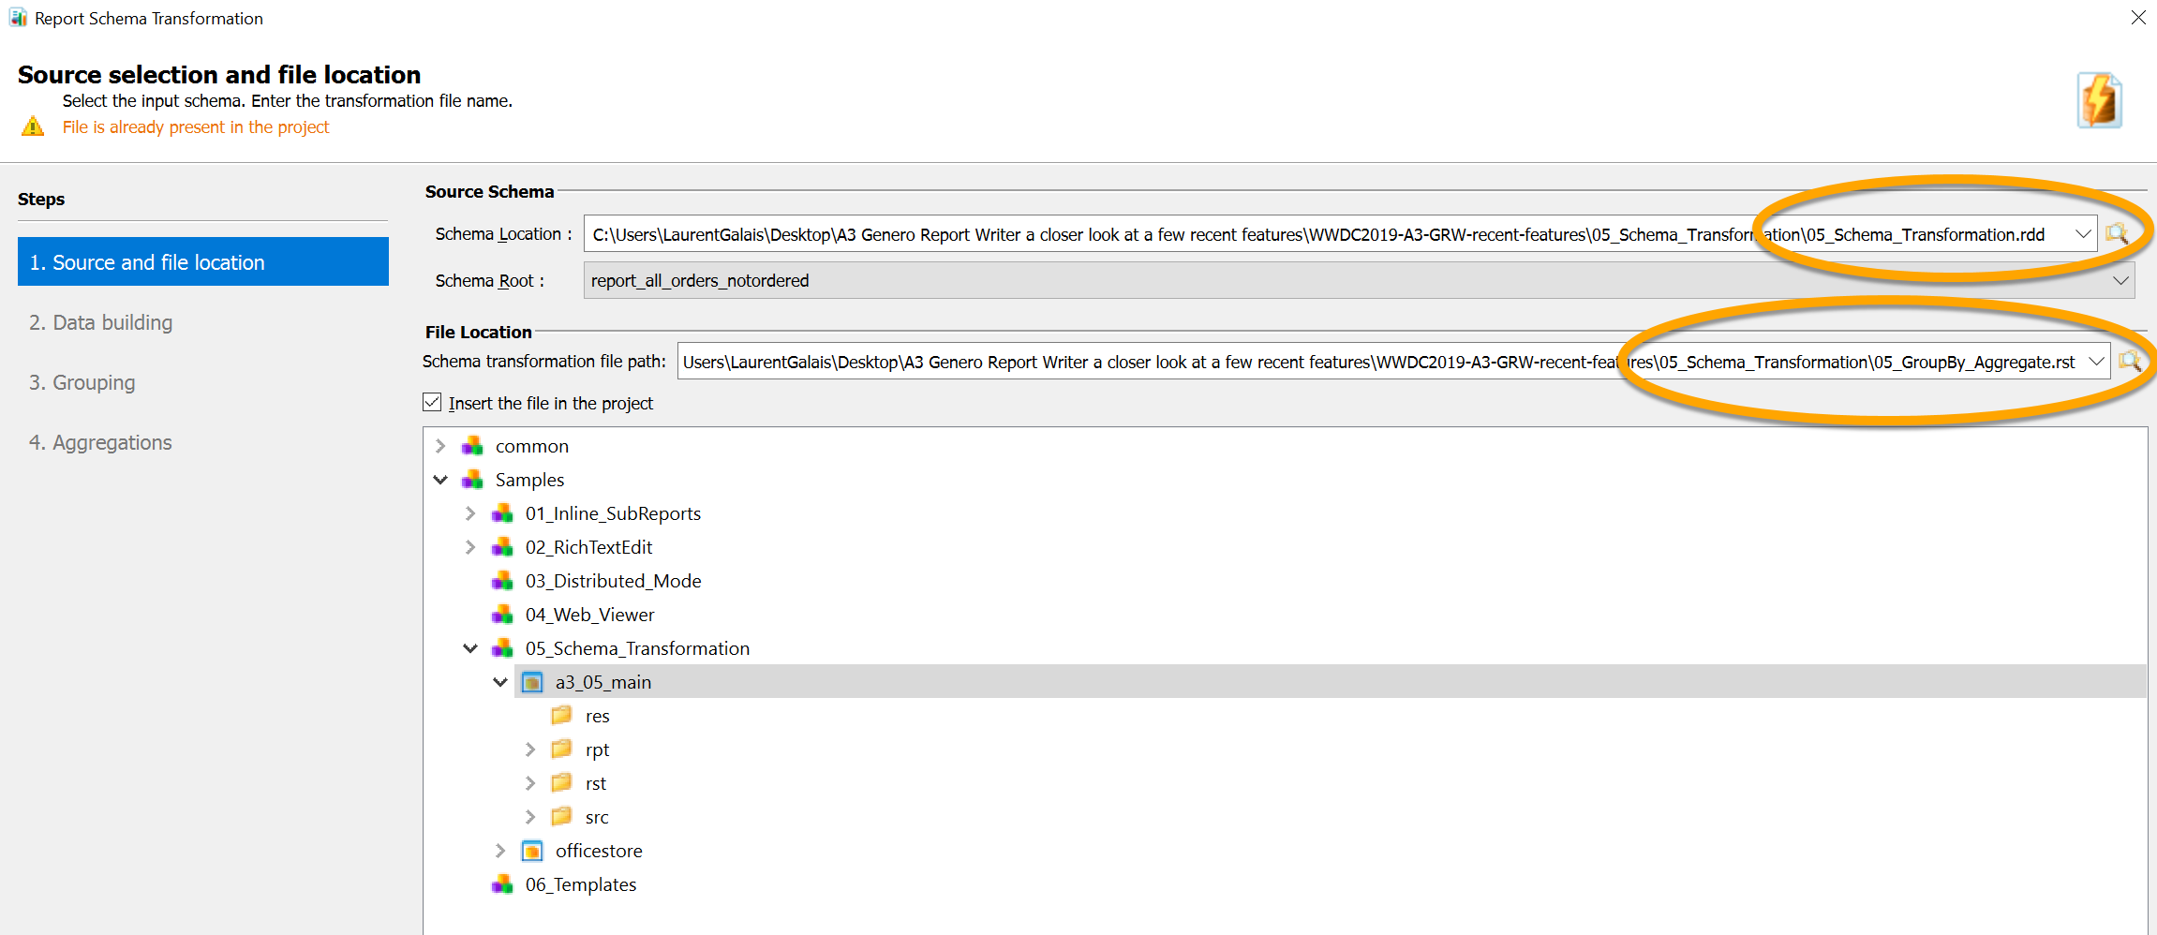
Report Schema Transformation
Steps
Source selection and file location
Select Schema Location
file name of the schema to transform (RDD, XSD or RST)
Specify schema root
In case XSD contains multiple root elements
Specify schema transformation file path

Slide 31
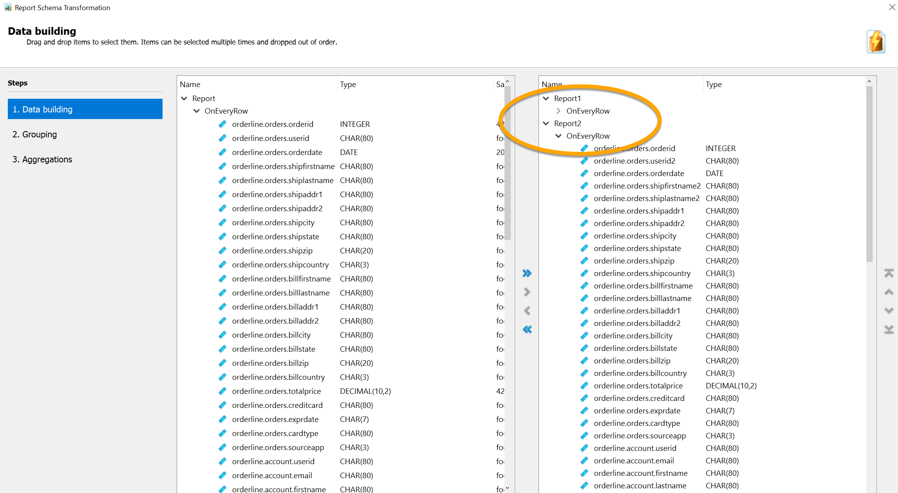
Report Schema Transformation
Steps
Data building
Select the data to be available on report design
Data can be re-ordered
Data can be renamed
Data should be renamed when used multiple times
Data can be duplicated by drag’n’droping multiple times
Notes:
Click on the proper area to GroupBy

Slide 32
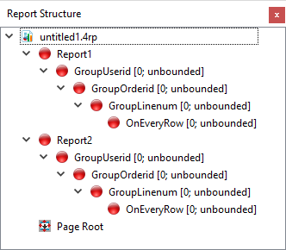
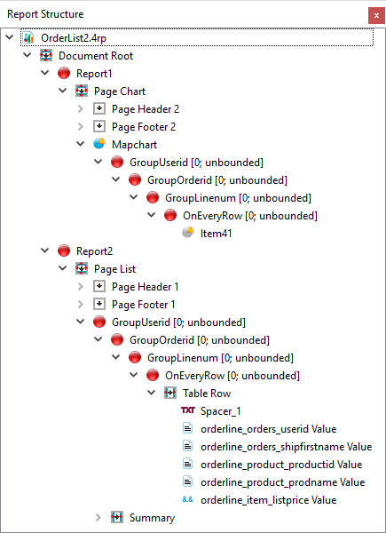
Report Schema Transformation
Example
Practical application: Duplicate data in a report
Create a report schema transformation (RST) that duplicates the data
Ensure to rename all variables that should appear twice in the report
Create a new Report design and load RST in Data view
Duplicated reports shown in Structure view
Add objects and rearrange Report Structure so that the data is displayed as required

Slide 33
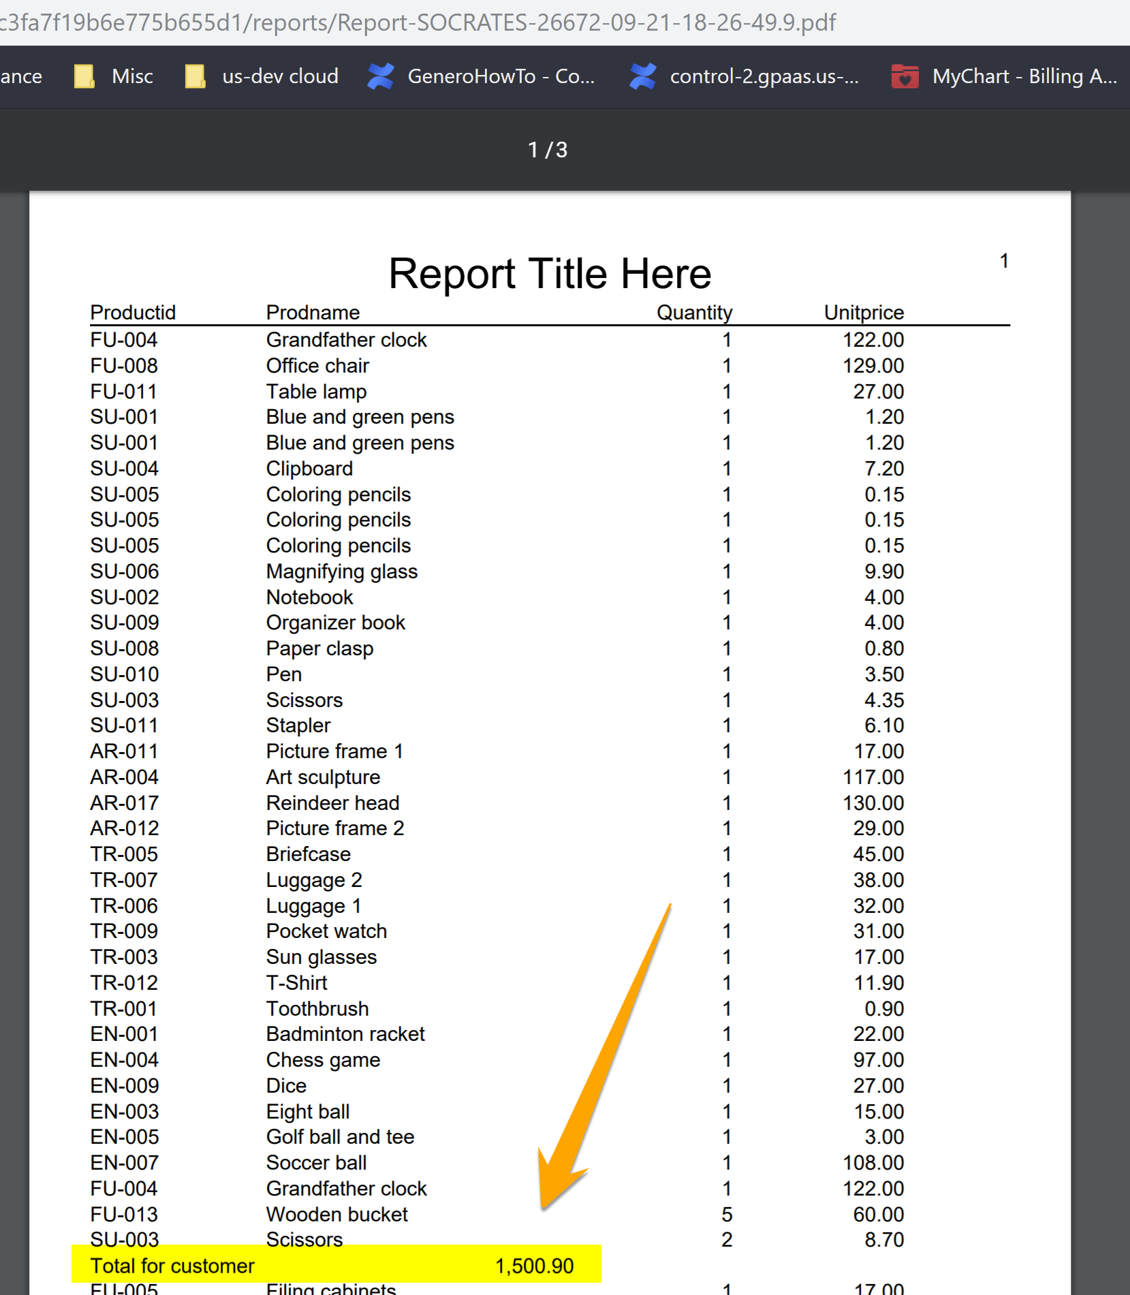
Report Schema Transformation
Example
Sum Aggregate added to a report: Typical usage
Compute a sum per customer since the data transferred is provided ‘raw’

Slide 34
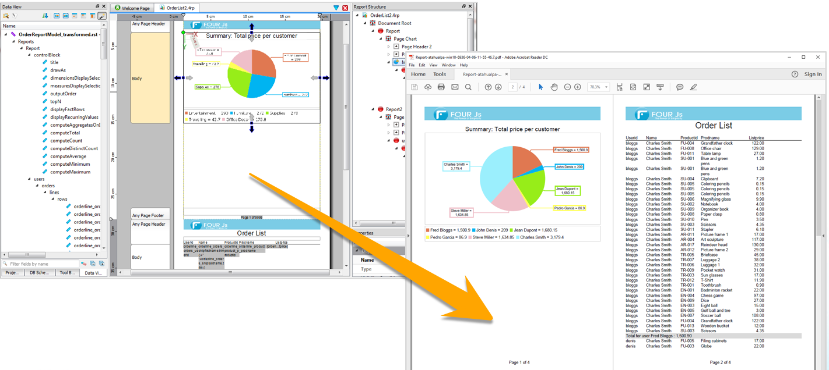
Report Schema Transformation
Example
Duplicate data in a report: Typical usage
Display a summary chart followed by details

Slide 35

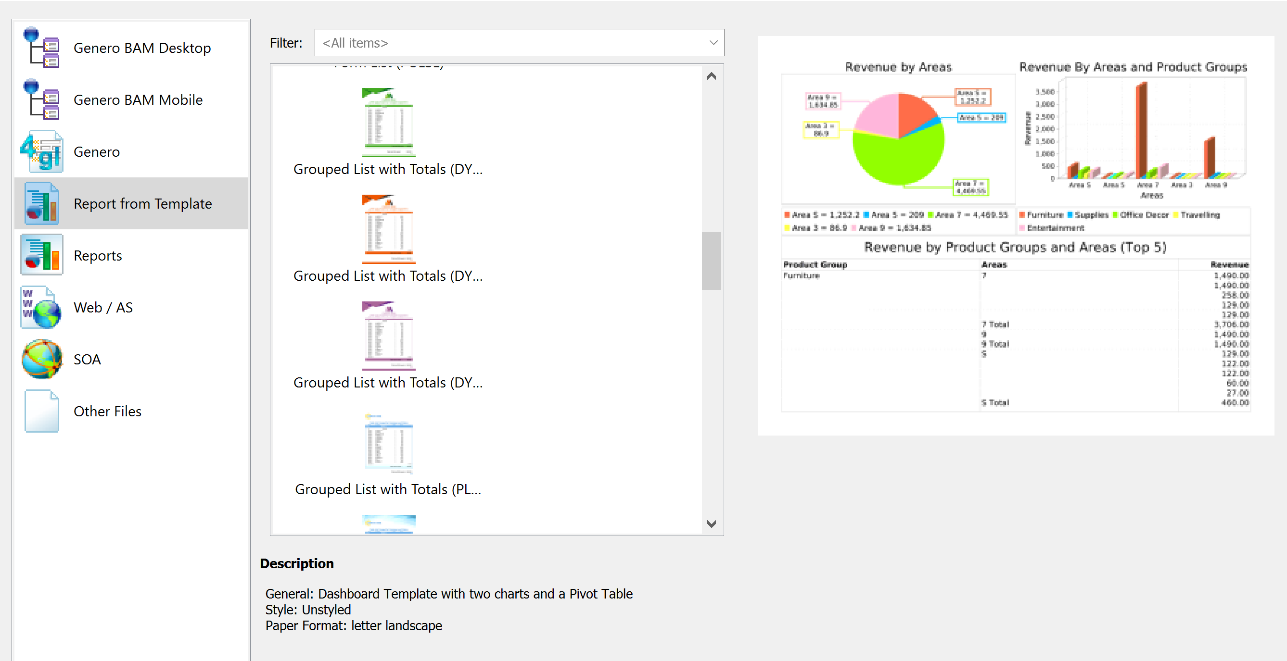
Report to Template
Subset of GRW templates feature
We are going to highlight the technique used to create a report template from an existing report
Check everything that Templates have to offer here
Notes:
Quick extra for fun !

Slide 36
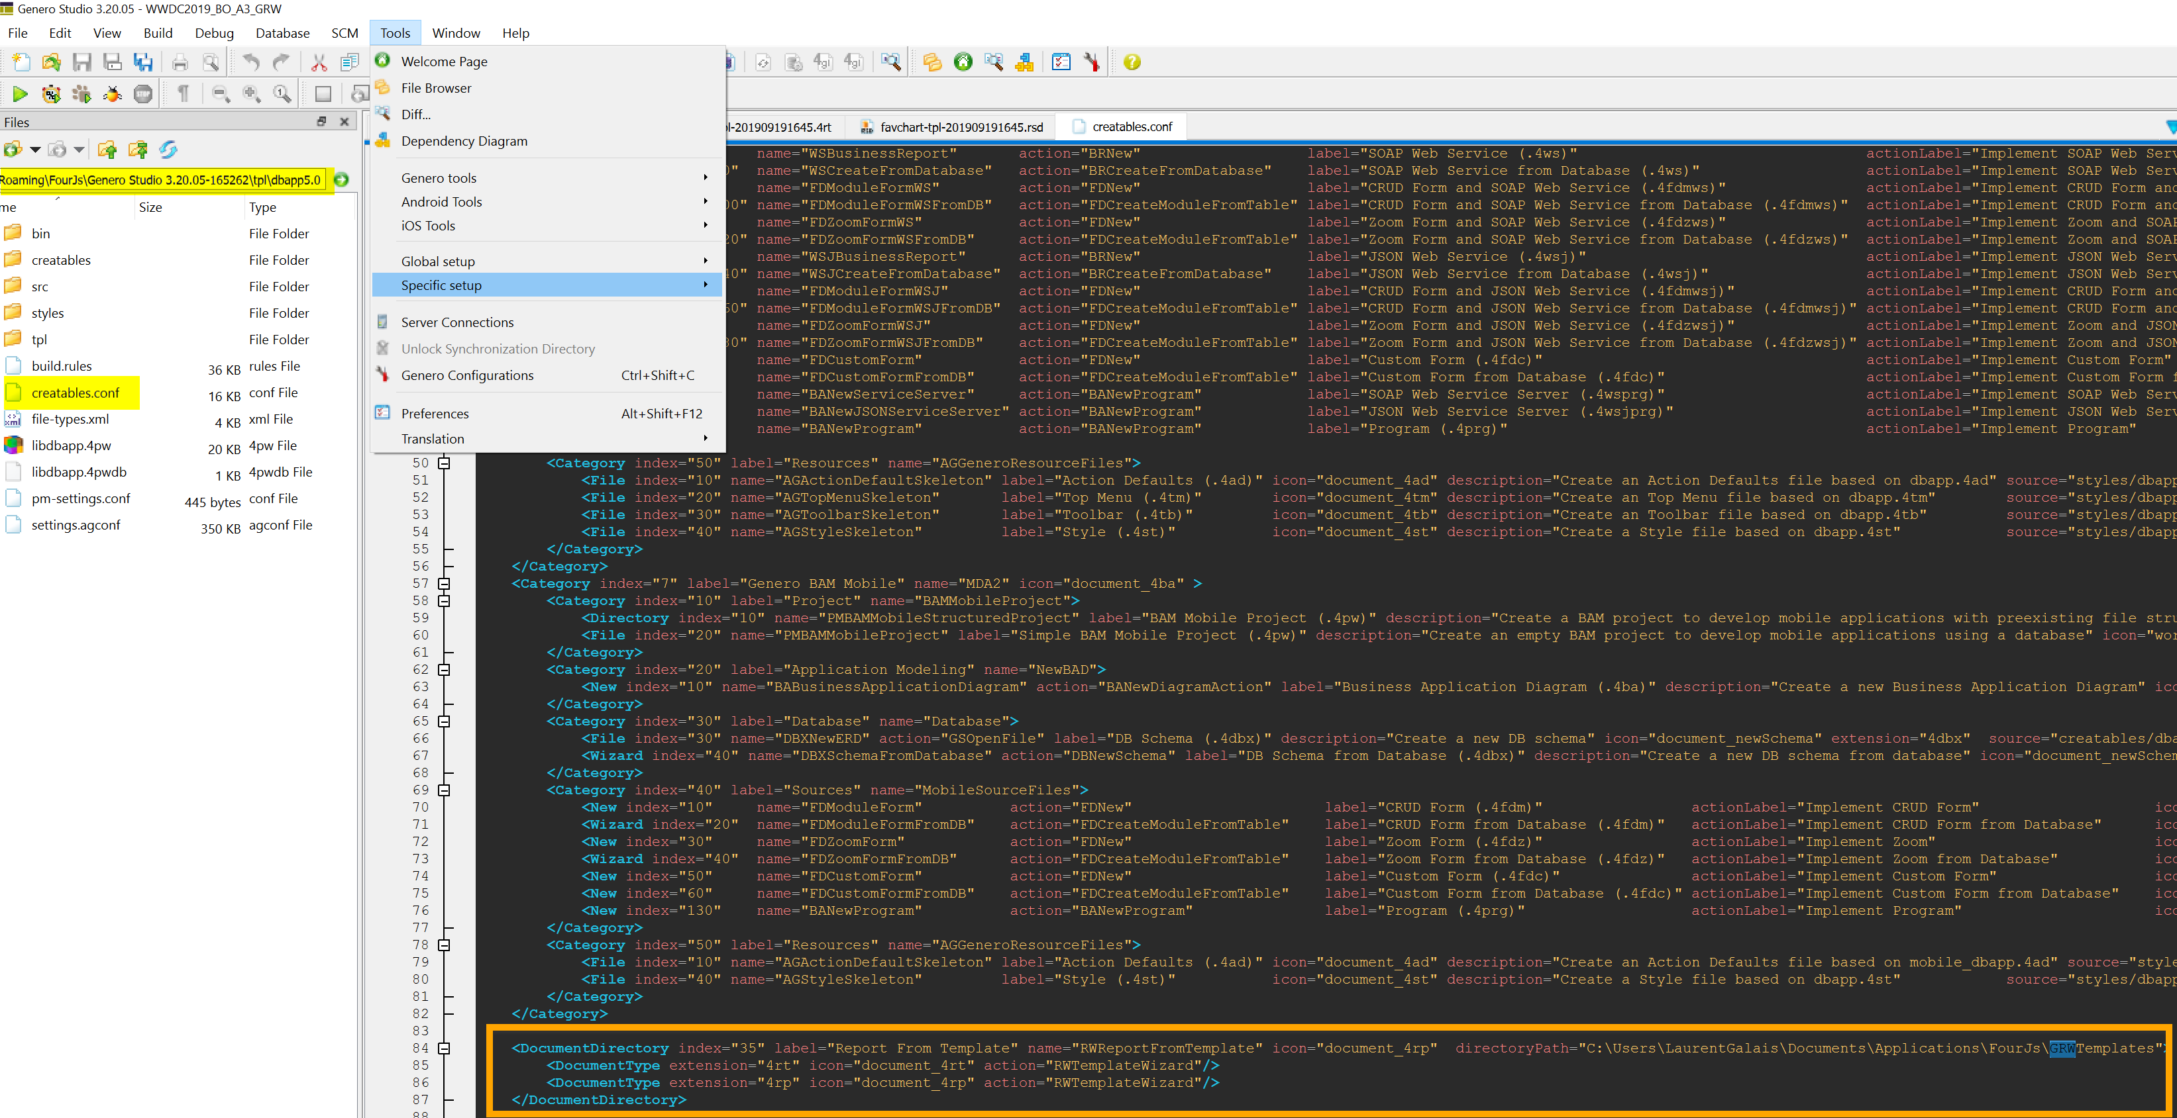
Create a template from an existing report
Preconfiguration
Create a directory to hold customized templates
mkdir ‘GRWTemplates’
Make sure it is configured to be accessible by GST
Creatables.conf

Slide 37
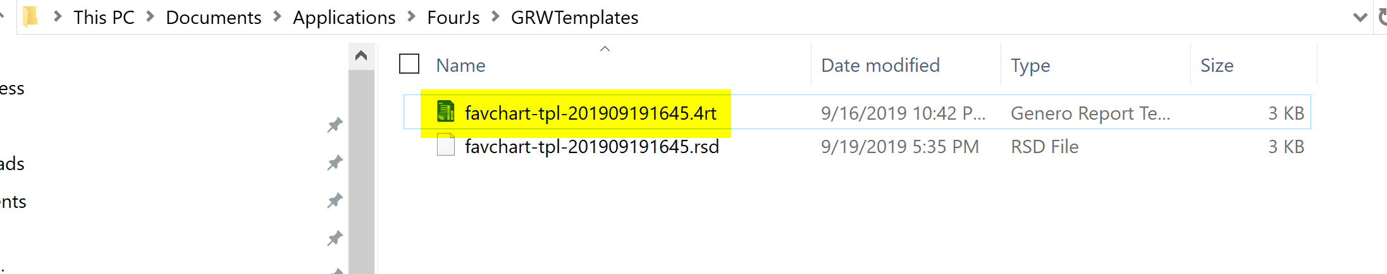
Create a template from an existing report
Step 1/5
Create a copy of the report design and rename it as a 4RT file
cp favchart.4rp favchart-tpl-201909191645.4rt

Slide 38
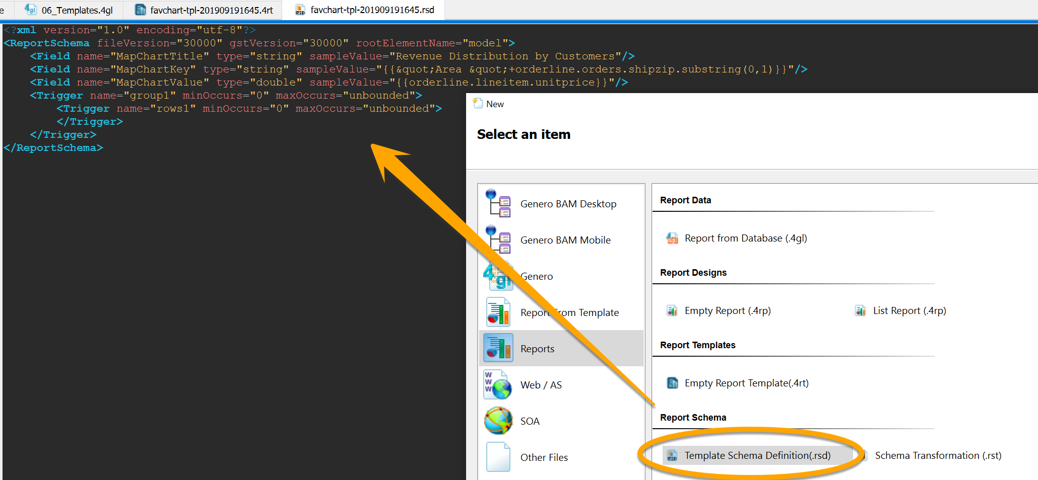
Create a template from an existing report
Step 1/5
Create a new report template schema (RSD file)
Report template schema definition
Specifies the structure of fields and groups in a template
File > New > Reports > Report Template Schema Definition(.rsd)
Tip1: You can open an existing an existing one
Tip2: Open the new created 4rt file to scan the structure

Slide 39
Create a template from an existing report
Step 2/5
Edit and update the report template (4RT) in Report Designer
Load RSD file previously created in Data View
Replace value of variable placeholders with values from template schema
Replace the rows of fields with a Template Field placeholder
Replace any column headers with a Template Field
Organize report structure (put TemplateField objects under fields triggers)

Slide 40
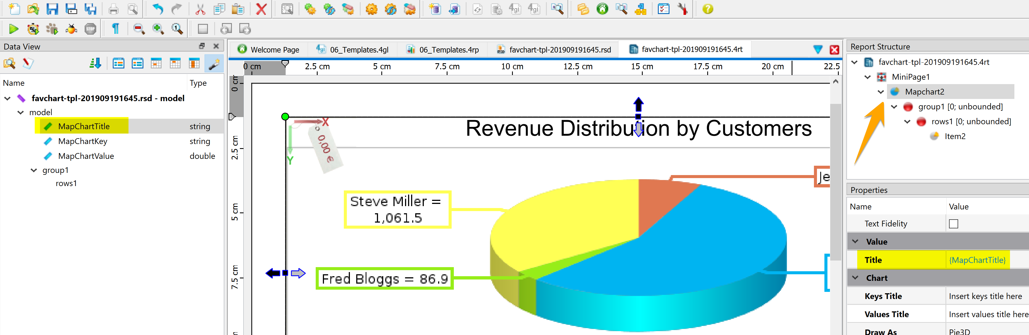
Create a template from an existing report
Step 2/5

Slide 41
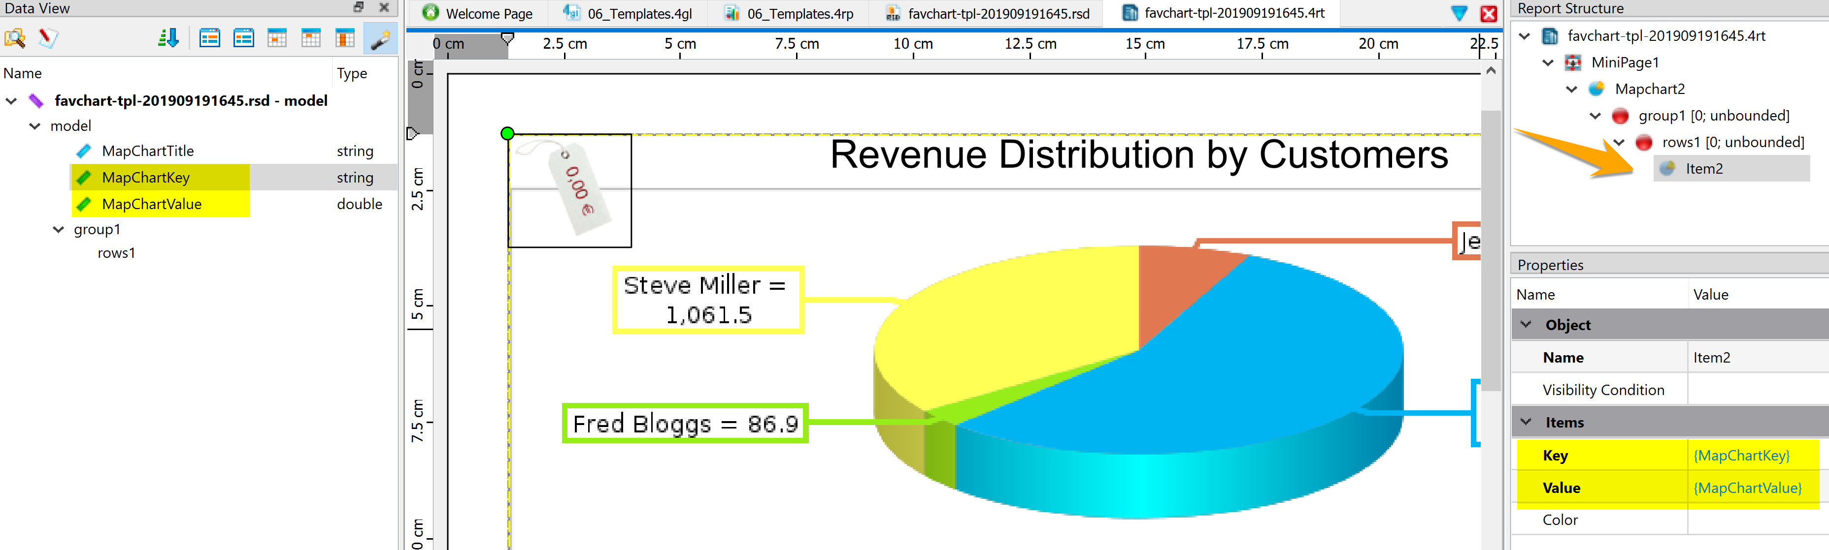
Create a template from an existing report
Step 2/5

Slide 42
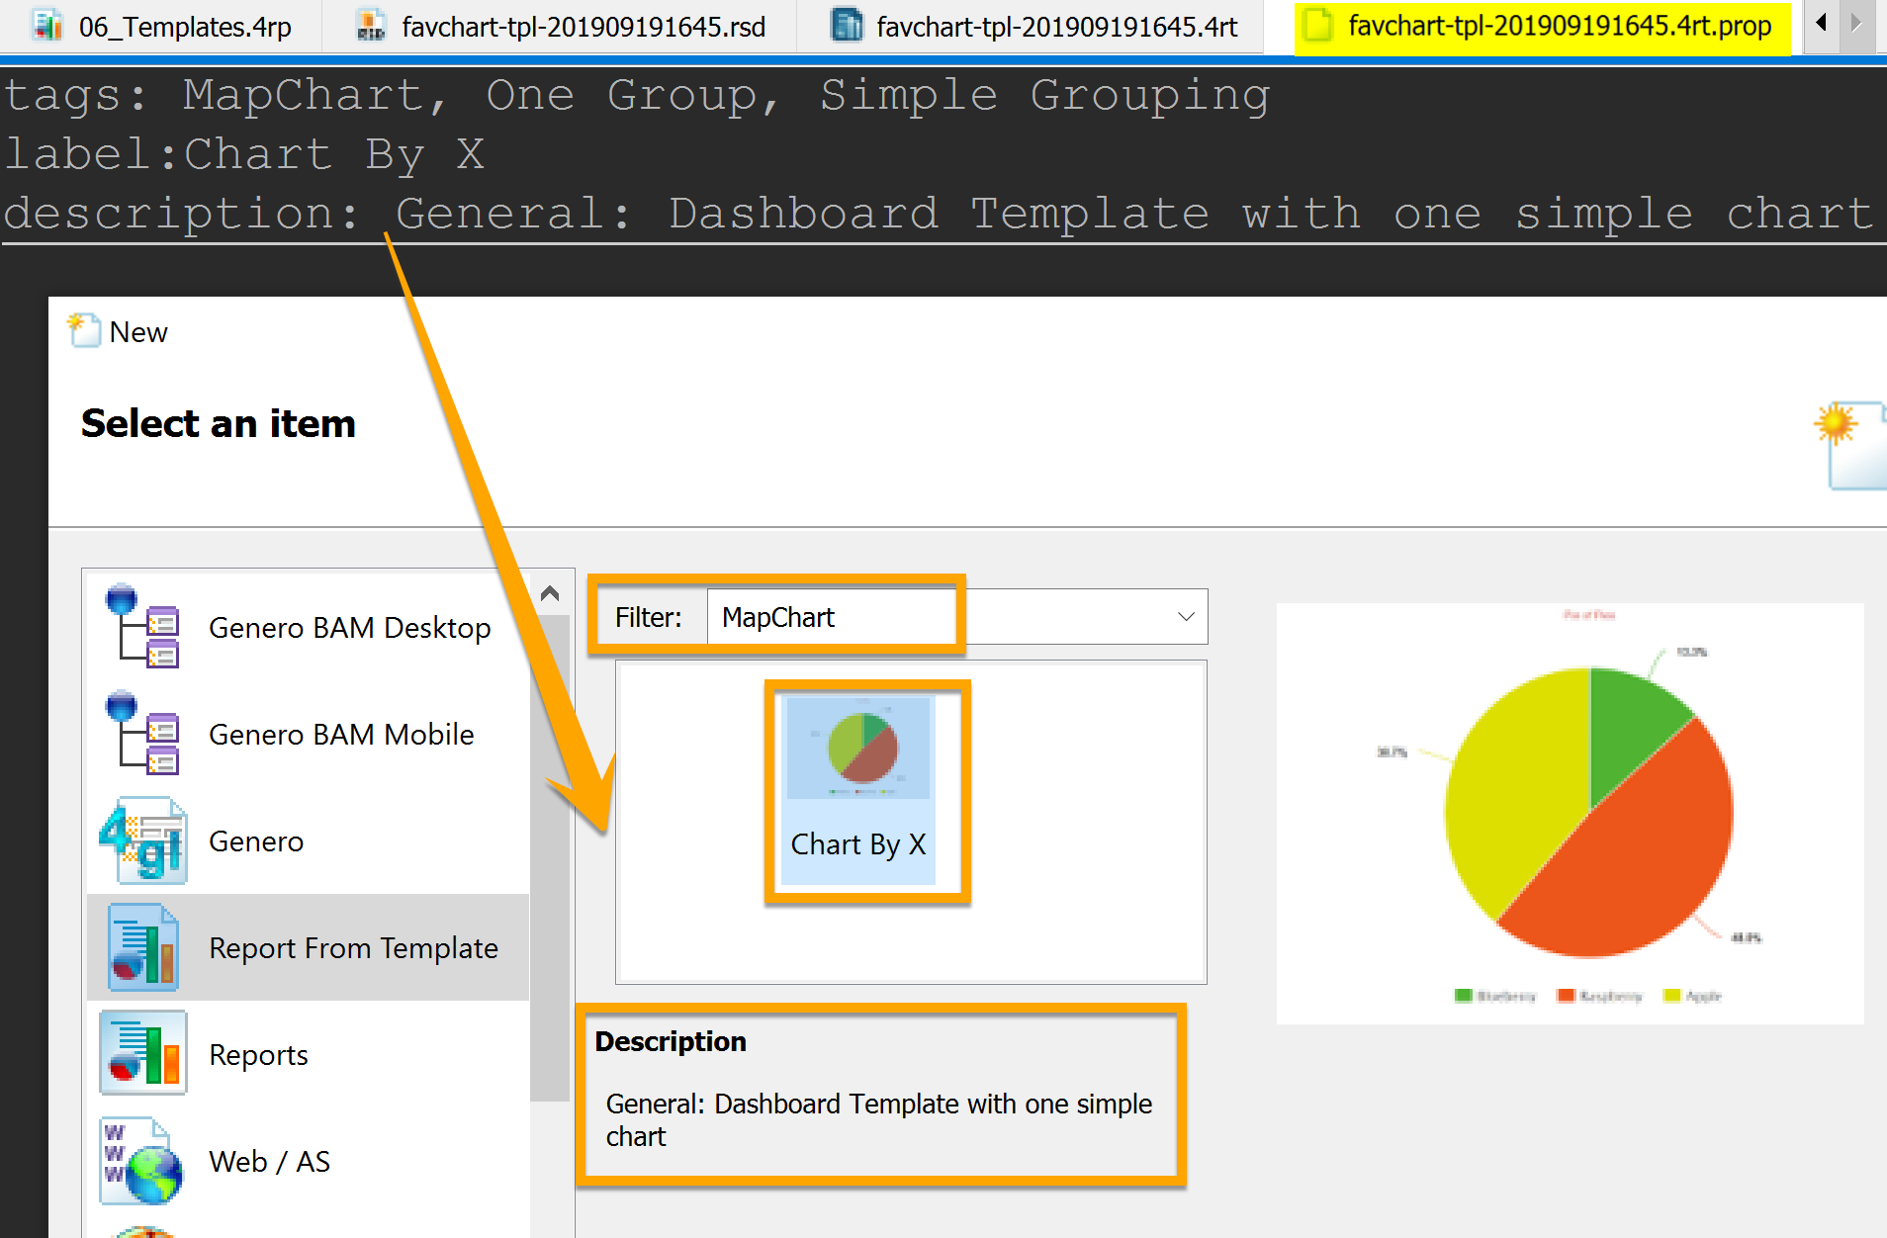
Create a template from an existing report
Step 3/5
Define template properties
Create template properties file (PROP) to specify template name, description and filtering tags
Same name as report template with the extension *.4rt.prop

Slide 43
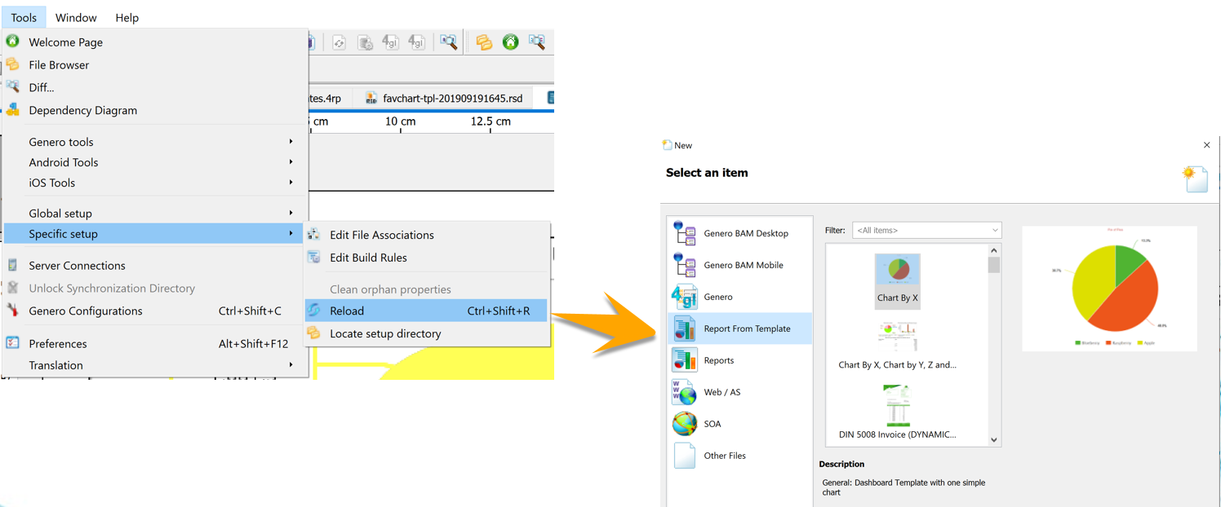
Create a template from an existing report
Step 5/5
Create template image files
Thumbnail image in the list of templates: <TEMPLATENAME>.4rt.png
Reload settings (Tools > Specific Setup > Reload)
Notes:
Optional:
Screenshots of the different steps in the New Report from Template Wizard
Schema association images: <PLACEHOLDERNAME>_placeholder.png
Add fields images: field_field<NUMBER>.png
Variables images: <TRIGGERNAME>_trigger.png

Slide 44

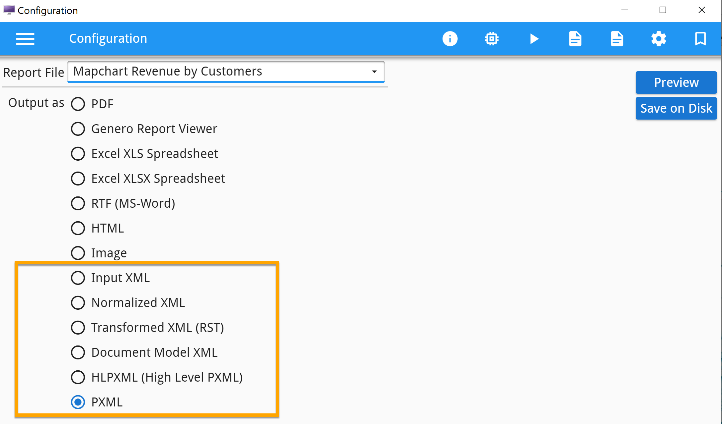
Non-process-level XML files creation
New min 3.20
When producing documents, GRE creates intermediate XML output files
A few more options available to ‘fgl_report_selectDevice’
From Input XML to PXML
The output file can be specified calling fgl_report_setOutputFileName()
Useful if in need to process the output of a report with other tools
Notes:
As the report is processed through various filters on its path from the DVM to the final report output, the GRE creates XML output files. You can use these files to perform operations on the intermediary data, for example, to produce charts
In my opinion this feature is useful for anyone wanting to process the output of a report with other tools. It also gives great insight on the inner workings of the pipe (how things are transformed from one format to another). For example the "Document Model XML" for OrderReport is very interesting. If you run the OrderReport.4rp you will see only the variables that are used in the report as a data stream. If you run one of the charts then it may be surprising how few variables are actually used to render the charts.
Input XML: The XML as provided by the 4gl application. The Input XML file is identical to the files obtained by callingfgl_report_createProcessLevelDataFile() or fgl_report_setProcessLevelDataFile()
PXML: A document in the Genero Report Writer PXML Expression language.
Let’s have a look at OrderReport demo

Slide 45

Genero Report Writer
Follow-up suggestions
GSTDIR/gst/samples/Reports
Always updated with the latest features
Github breakout sample link
https://github.com/FourJsLG/WWDC2019_BO_A3_GRW
Off the beaten path tutorials
generoreportwriter.com tutorials
Notes:
Quick extra for fun !

Slide 46

Genero Report Writer
Questions?
Q & A
Notes:
Quick extra for fun !

Slide 47

Laurent Galais
lg@4js.com

